Slide 1
Big Data Analytics in Manufacturing
Ark Mishara

Slide 2


Slide 3
What is Apache Hadoop?
Open source software framework designed for storage and processing of large scale data on clusters of commodity hardware
Created by Doug Cutting and Mike Carafella in 2005.
Cutting named the program after his son’s toy elephant.

Slide 4
Uses for Hadoop
Data-intensive text processing
Assembly of large genomes
Graph mining
Machine learning and data mining
Large scale social network analysis

Slide 5
















Who Uses Hadoop?

Slide 6
The Hadoop Ecosystem
Hadoop Common
Contains Libraries and other modules
HDFS
Hadoop Distributed File System
Hadoop YARN
Yet Another Resource Negotiator
Hadoop MapReduce
A programming model for large scale data processing

Slide 7
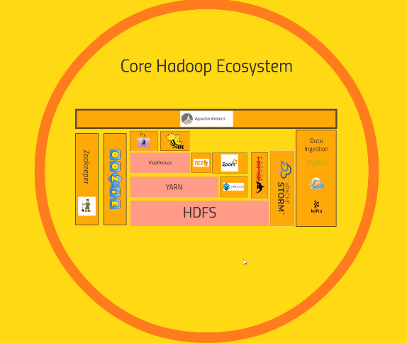
Hadoop Ecosystem

Slide 8
Motivations for Hadoop
What considerations led to its design

Slide 9
Motivations for Hadoop
What were the limitations of earlier large-scale computing?
What requirements should an alternative approach have?
How does Hadoop address those requirements?

Slide 10
Early Large Scale Computing
Historically computation was processor-bound
  Data volume has been relatively small
  Complicated computations are performed on that data
Advances in computer technology has historically centered around improving the power of a single machine

Slide 11
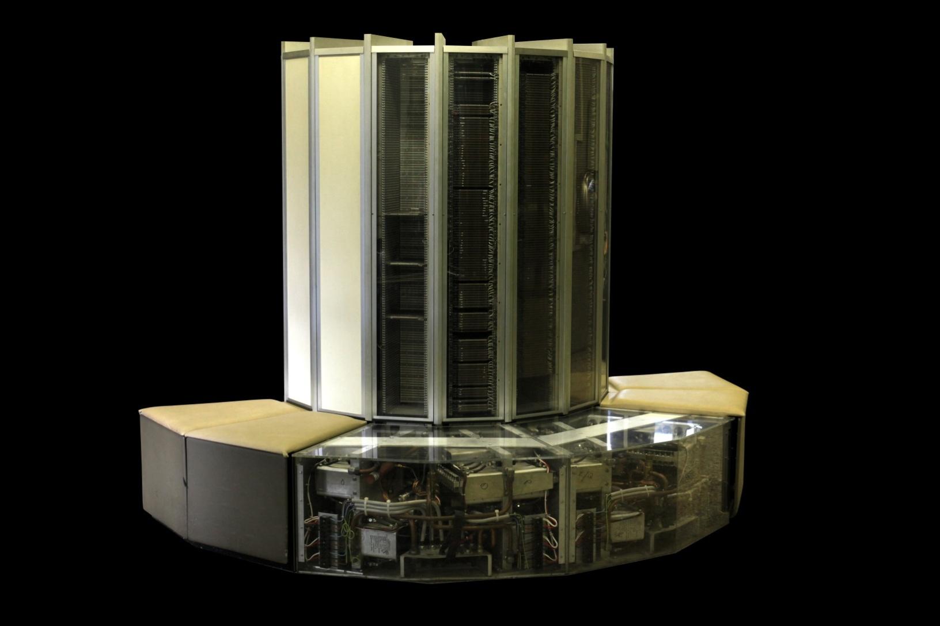
Cray-1

Slide 12
Advances in CPUs
Moore’s Law
  The number of transistors on a dense integrated circuit doubles every two years
Single-core computing can’t scale with current computing needs

Slide 13

Single-Core Limitation
Power consumption limits the speed increase we get from transistor density

Slide 14
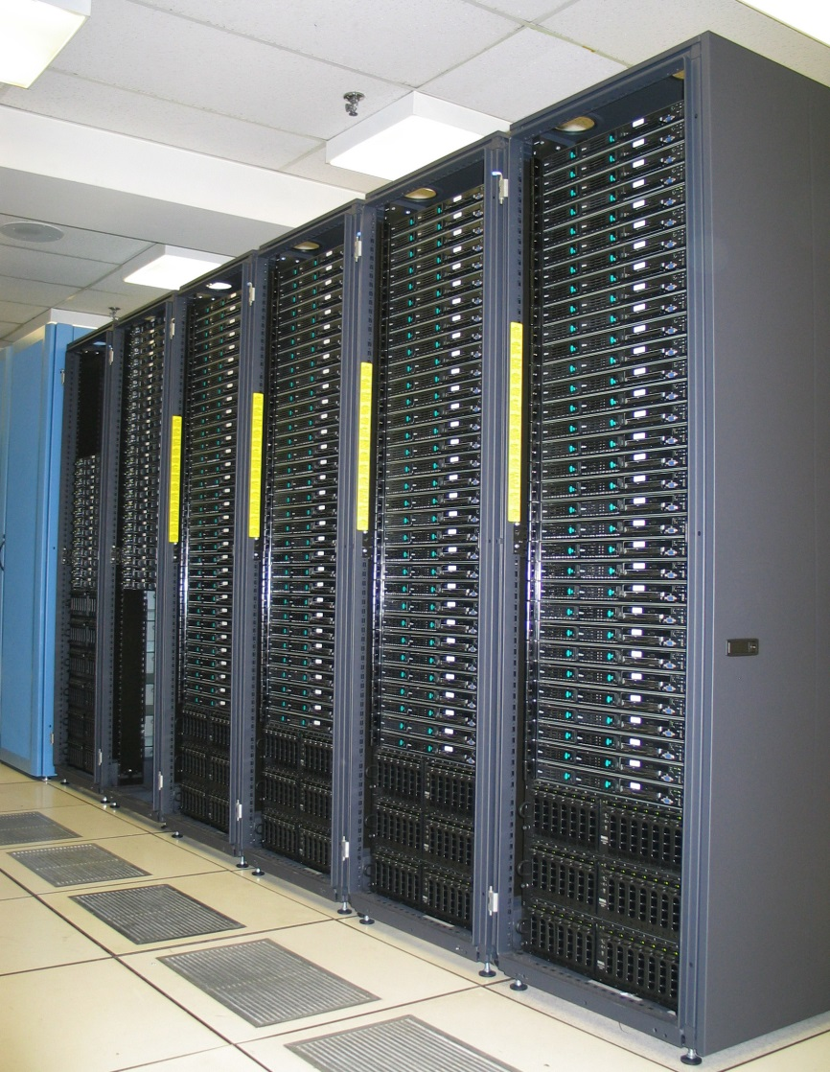
Distributed Systems
Allows developers to use multiple machines for a single task

Slide 15
Distributed System: Problems
Programming on a distributed system is much more complex
  Synchronizing data exchanges
  Managing a finite bandwidth
  Controlling computation timing is complicated

Slide 16
Distributed System: Problems
“You know you have a distributed system when the crash of a computer you’ve never
heard of stops you from getting any work done.” –Leslie Lamport
Distributed systems must be designed with the expectation of failure
Notes:
Example of failure issues. Linux lab is distributed file system, if the file server fails, what happens.

Slide 17
Distributed System: Data Storage
Typically divided into Data Nodes and Compute Nodes
At compute time, data is copied to the Compute Nodes
Fine for relatively small amounts of data
Modern systems deal with far more data than was gathering in the past

Slide 18
How much data?
Facebook
  500 TB per day
Yahoo
  Over 170 PB
eBay
  Over 6 PB
Getting the data to the processors becomes the bottleneck

Slide 19

Requirements for Hadoop
Must support partial failure
Must be scalable

Slide 20

Partial Failures
Failure of a single component must not cause the failure of the entire system only a degradation of the application performance
Failure should not result in the loss of any data

Slide 21
Component Recovery
If a component fails, it should be able to recover without restarting the entire system
Component failure or recovery during a job must not affect the final output

Slide 22
Scalability
Increasing resources should increase load capacity
Increasing the load on the system should result in a graceful decline in performance for all jobs
  Not system failure

Slide 23
Hadoop
Based on work done by Google in the early 2000s
  “The Google File System” in 2003
  “MapReduce: Simplified Data Processing on Large Clusters” in 2004
The core idea was to distribute the data as it is initially stored
  Each node can then perform computation on the data it stores without moving the data for the initial processing

Slide 24
Core Hadoop Concepts
Applications are written in a high-level programming language
  No network programming or temporal dependency
Nodes should communicate as little as possible
  A “shared nothing” architecture
Data is spread among the machines in advance
  Perform computation where the data is already stored as often as possible

Slide 25
High-Level Overview
When data is loaded onto the system it is divided into blocks
  Typically 64MB or 128MB
Tasks are divided into two phases
  Map tasks which are done on small portions of data where the data is stored
  Reduce tasks which combine data to produce the final output
A master program allocates work to individual nodes
Notes:
Example of map and reduce

Slide 26
Fault Tolerance
Failures are detected by the master program which reassigns the work to a different node
Restarting a task does not affect the nodes working on other portions of the data
If a failed node restarts, it is added back to the system and assigned new tasks
The master can redundantly execute the same task to avoid slow running nodes

Slide 27
Hadoop Distributed File System
HDFS

Slide 28
Overview
Responsible for storing data on the cluster
Data files are split into blocks and distributed across the nodes in the cluster
Each block is replicated multiple times

Slide 29
HDFS Basic Concepts
HDFS is a file system written in Java based on the Google’s GFS
Provides redundant storage for massive amounts of data

Slide 30
HDFS Basic Concepts
HDFS works best with a smaller number of large files
  Millions as opposed to billions of files
  Typically 100MB or more per file
Files in HDFS are write once
Optimized for streaming reads of large files and not random reads

Slide 31
How are Files Stored
Files are split into blocks
Blocks are split across many machines at load time
  Different blocks from the same file will be stored on different machines
Blocks are replicated across multiple machines
The NameNode keeps track of which blocks make up a file and where they are stored
Notes:
Default replication is 3-fold

Slide 32
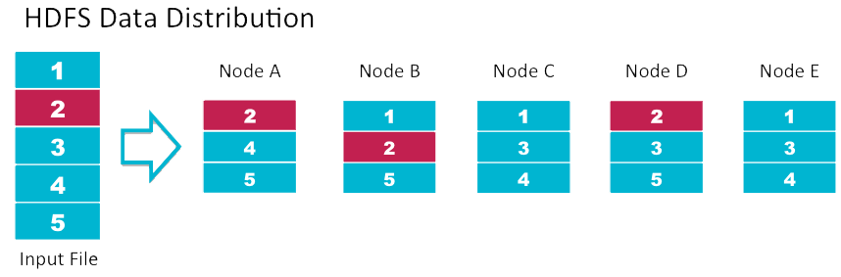
Data Replication
Default replication is 3-fold

Slide 33
Data Retrieval
When a client wants to retrieve data
  Communicates with the NameNode to determine which blocks make up a file and on which data nodes those blocks are stored
  Then communicated directly with the data nodes to read the data

Slide 34
MapReduce
Distributing computation across nodes

Slide 35
MapReduce Overview
A method for distributing computation across multiple nodes
Each node processes the data that is stored at that node
Consists of two main phases
  Map
  Reduce

Slide 36
MapReduce Features
Automatic parallelization and distribution
Fault-Tolerance
Provides a clean abstraction for programmers to use

Slide 37


Slide 38
The Mapper
Reads data as key/value pairs
  The key is often discarded
Outputs zero or more key/value pairs

Slide 39
Shuffle and Sort
Output from the mapper is sorted by key
All values with the same key are guaranteed to go to the same machine

Slide 40
The Reducer
Called once for each unique key
Gets a list of all values associated with a key as input
The reducer outputs zero or more final key/value pairs
  Usually just one output per input key

Slide 41
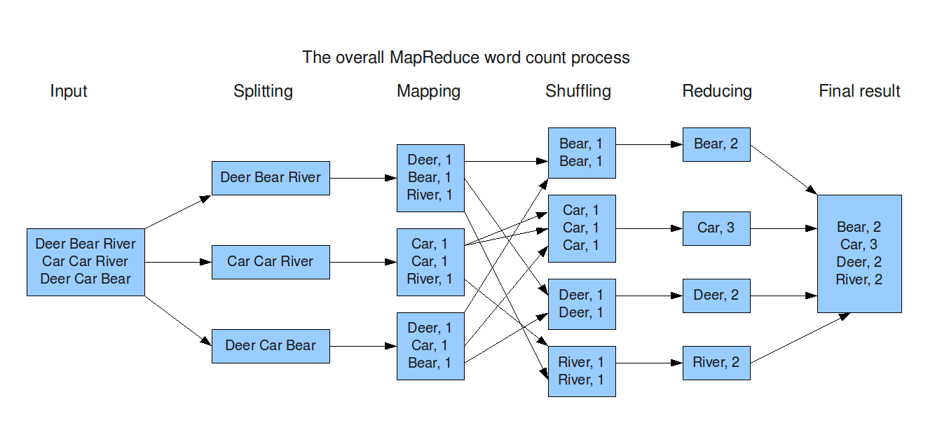
MapReduce: Word Count

Slide 42
Anatomy of a Cluster
What parts actually make up a Hadoop cluster

Slide 43
Overview
NameNode
  Holds the metadata for the HDFS
Secondary NameNode
  Performs housekeeping functions for the NameNode
DataNode
  Stores the actual HDFS data blocks
JobTracker
  Manages MapReduce jobs
TaskTracker
  Monitors individual Map and Reduce tasks

Slide 44
The NameNode
Stores the HDFS file system information in a fsimage
Updates to the file system (add/remove blocks) do not change the fsimage file
  They are instead written to a log file
When starting the NameNode loads the fsimage file and then applies the changes in the log file

Slide 45
The Secondary NameNode
NOT a backup for the NameNode
Periodically reads the log file and applies the changes to the fsimage file bringing it up to date
Allows the NameNode to restart faster when required

Slide 46
JobTracker and TaskTracker
JobTracker
  Determines the execution plan for the job
  Assigns individual tasks
TaskTracker
  Keeps track of the performance of an individual mapper or reducer

Slide 47
Hadoop Ecosystem
Other available tools

Slide 48
Why do these tools exist?
MapReduce is very powerful, but can be awkward to master
These tools allow programmers who are familiar with other programming styles to take advantage of the power of MapReduce

Slide 49
Other Tools
Hive
  Hadoop processing with SQL
Pig
  Hadoop processing with scripting
Cascading
  Pipe and Filter processing model
HBase
  Database model built on top of Hadoop
Flume
  Designed for large scale data movement

